Slide 1

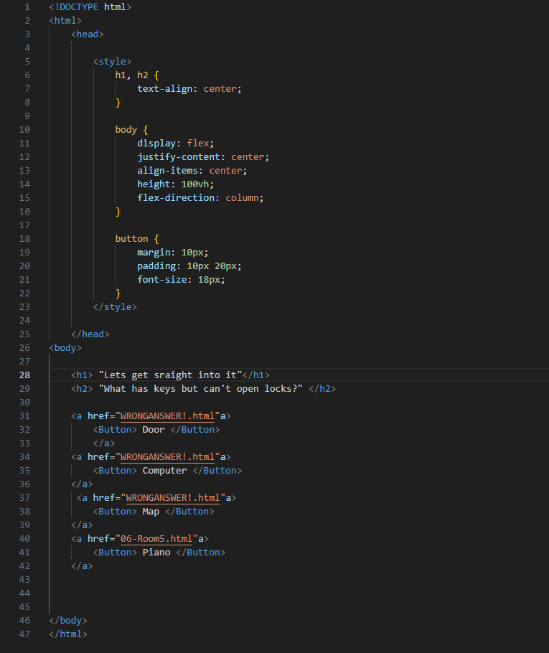
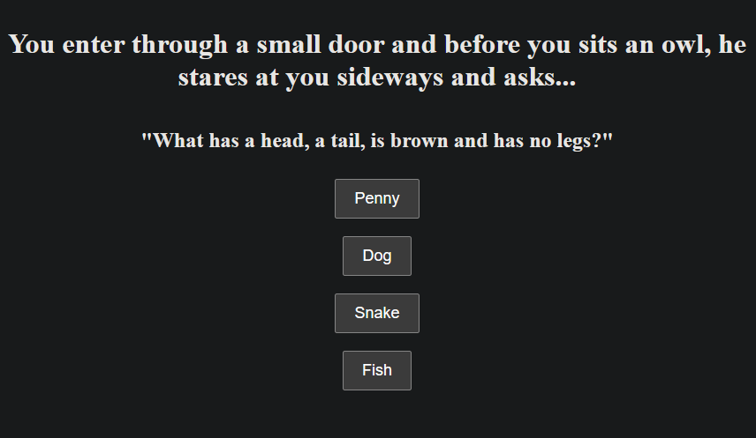
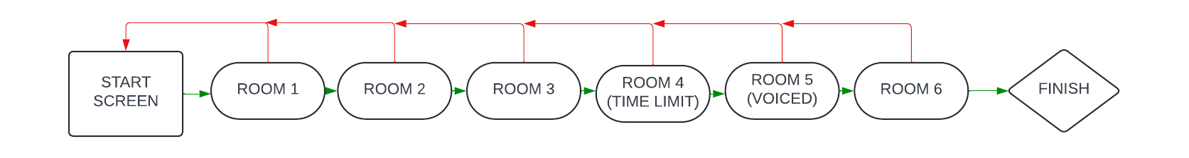
My SPA – A text-based riddle game
The riddle Screen
A brief description of the room and an owl speaking to you
4 answers, 3 wrong, 1 correct
Correct answer takes you to the next room
Wrong answer take you back to the start
The basic coding for my game
Uses a basic Hyperlink System
Changes between the next room if guessed correctly
Back to the start if incorrect
Finishes the Game if you get to the end
The Layout of the rooms
Starts with a start screen
Six rooms after, all with a riddle
Wrong answers takes you back to the start (Red lines)
Last room finishes the game

